Slide 1




Tradeoffs in disinfection byproduct management
Lofton, M.E., Cooke, R.L., and Carey, C.C. 20 September 2025.
Macrosystems EDDIE: Exploring Tradeoffs in Water Quality Management Using Environmental Data.
Macrosystems EDDIE Module 10, Version 1.
https://serc.carleton.edu/eddie/teaching_materials/modules/module10.html
Module development supported by NSF EF-2318861 and NSF RISE-2438447.
Notes:
In this video, I will discuss tradeoffs in disinfection byproduct management.

Slide 2
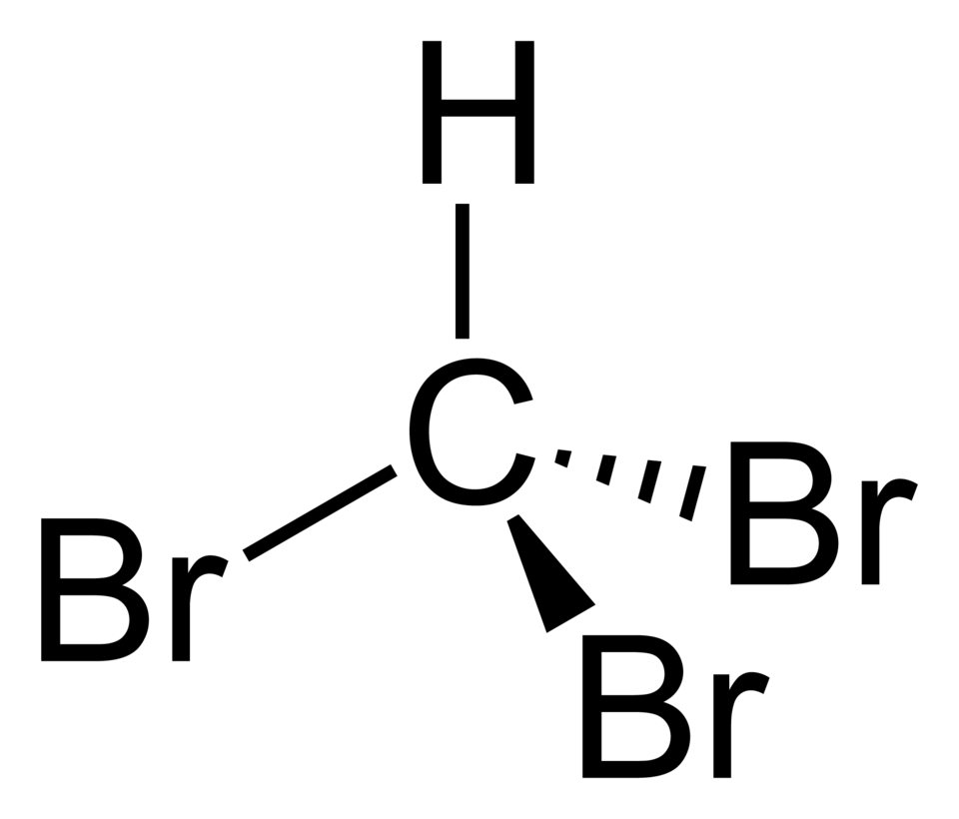
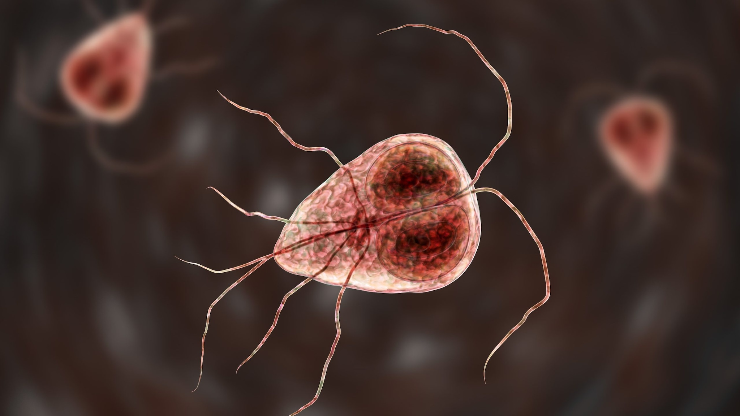

Operators must balance the risks of incomplete disinfection and DBP formation
Balancing the presence of harmful pathogens with the presence of DBPs
Notes:
During the treatment process, operators must balance the risks of incomplete disinfection and DBP formation. If disinfection is incomplete, there may be harmful pathogens in the finished water, threatening human health. However, chlorine-containing compounds used for disinfection can also react with DBP precursors to form cancer-causing disinfection byproducts, also threatening human health. Therefore, an operator has two goals: ensure disinfection and avoid DBP formation.

Slide 3
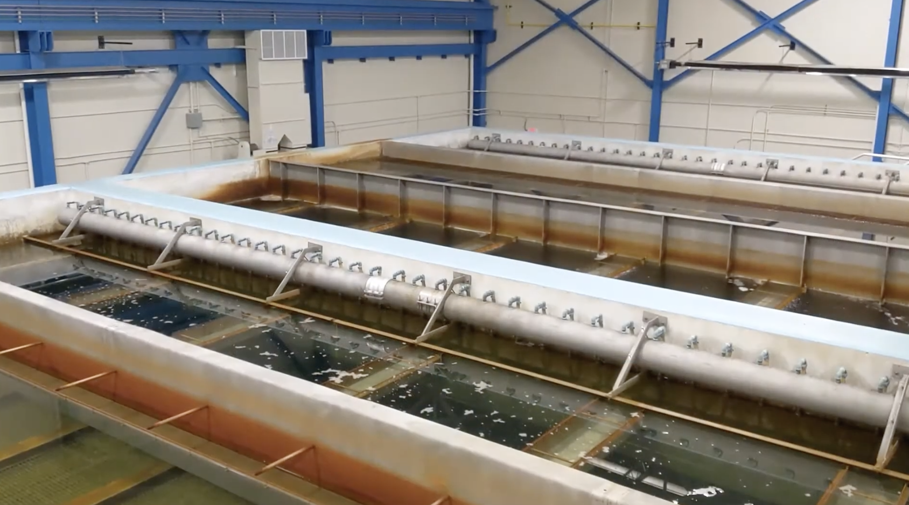
Goal #1: Ensure disinfection
Chlorine should be added until all harmful pathogens are destroyed
In addition, enough chlorine should be added to produce some free residual chlorine which keeps the water free of pathogens in the distribution system
Spring Hollow Reservoir Treatment Plant
Photo credit: Western Virginia Water Authority
Notes:
To meet goal #1, Chlorine should be added until all harmful pathogens are destroyed
In addition, enough chlorine should be added to produce some free residual chlorine which keeps the water free of pathogens in the distribution system

Slide 4
Goal #1: Ensure disinfection
The amount of chlorine added is the chlorine dose
The chlorine used up by pathogens and other substances in the water is the chlorine demand
The chlorine left over from the dose after demand is satisfied is the chlorine residual
Spring Hollow Reservoir Treatment Plant
Photo credit: Western Virginia Water Authority
Notes:
To better understand this concept, we are going to introduce some key terminology and calculations that you will need to know to operate a drinking water treatment plant. First, the amount of chlorine added is the chlorine dose, while the chlorine used up by pathogens and other substances in the water is the chlorine demand. The chlorine left over from the dose after demand is satisfied is the chlorine residual.

Slide 5
Goal #1: Ensure disinfection
Dose = Demand + Residual
(all in mg/L)
Example Question: What chlorine dosage should be applied to raw water with a demand of 0.5 mg/L and an intended residual of 1.1 mg/L?
Answer:
Dose (mg/L) = 0.5 mg/L + 1.1 mg/L
Dose = 1.6 mg/L
Notes:
This brings us to our first calculation: the dose calculation. The chlorine dose in mg/L is equal to the demand plus the residual, which are both also in mg/L. So for example, if you needed to know what chlorine dosage should be applied to raw water with a demand of 0.5 mg/L and an intended residual of 1.1 mg/L, you would add the demand and the residual to find that your dosage should be 1.6 mg/L.

Slide 6
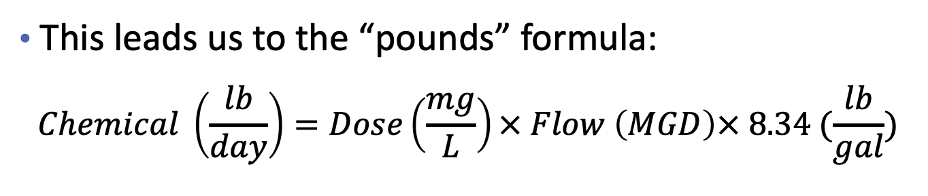
Goal #1: Ensure disinfection
This leads us to the “pounds” formula:
$$Chemical \left(\frac{lb}{day}\right)=Dose\left(\frac{mg}{L}\right)× Flow \left(MGD\right)× 8.34 (\frac{lb}{gal})$$
The equation says that the chlorine added per day is equal to the chlorine dose times the flow times the constant: 8.34 lb/gal (which is the number of pounds of water per gallon).
Example Question: What should the chlorine feed rate setting be in lb/day if the plant flow is 0.8 MGD and the required chlorine dose is 1.6 mg/L?
Answer:
Chemical (lb/day) = 1.6 mg/L x 0.8 MGD x 8.34 lb/gal
Chemical = 10.7 lb/day
Notes:
Once you know the required dose, you might also need to know how much chlorine chemical to feed per day to achieve that dosage, given the flow in the plant you are operating. To find out how much chemical to feed in lbs per day, you would use the “pounds” formula. It says that the chlorine chemical in pounds per day is equal to the chlorine dose times the flow in the plant times the constant: 8.34 lb/gal (which is the number of pounds of water per gallon). So for example, if you needed to know the chlorine feed rate setting in lb/day given a plant flow of 0.8 million gallons per day and a required chlorine dose of 1.6 mg/L, you would multiply dose by the flow and then by the constant 8.34 lb/gal to determine that you need to feed 10.7 lb/day of chlorine.

Slide 7
Goal #1: Ensure disinfection
Breakpoint chlorination is a useful framework that helps operators know how much chlorine is needed for disinfection and production of free residual chlorine
Spring Hollow Reservoir Treatment Plant
Photo credit: Western Virginia Water Authority
Notes:
The final concept we will cover related to ensuring disinfection is breakpoint chlorination. Breakpoint chlorination is a useful framework that helps operators know how much chlorine is needed for disinfection and production of free residual chlorine.

Slide 8
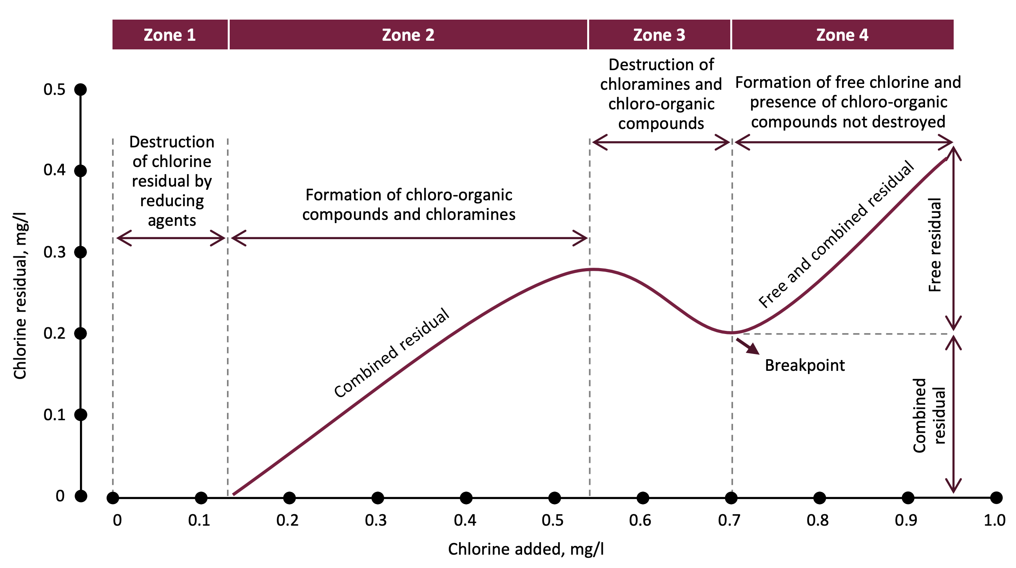
Goal #1: Ensure disinfection
Chlorine should be added until the “breakpoint” on the figure is reached to ensure complete disinfection.
Image source: https://waterbypureflow.com/wp-content/uploads/2022/11/Breakpoint-Chlorination-Bulletin-No.T-BPC061022.0-221004-004.pdf
Notes:
To ensure complete disinfection, chlorine should be added until the “breakpoint” on the figure is reached. Let’s walk step-by-step through the figure. On the x axis, we have the amount of chlorine added during treatment, while on the y axis, we have the amount of chlorine residual left after disinfection occurs. In the first zone on the figure, when only a little chlorine is added to the water, that chlorine reacts with reducing agents in the water (such as iron, manganese, and nitrite), and there is no residual left over. In zone 2, as more chlorine is added, the chlorine reacts with ammonia and organic matter to form chloramines and chloroorganic compounds (combined residual chlorine). The primary reaction in this zone is the reaction of chlorine and ammonia, resulting in combined residual of primarily monochloramine. In zone 3, the addition of more chlorine leads to destruction of the chloro-organic compounds and monochloramine from zone 2, leading to decreased combined residual. This zone is also where formation of dichloramines and trichloramines can also occur, which can lead to taste and odor problems in drinking water. until the breakpoint is reached. At the dip between zones 3 and 4, known as the breakpoint, these dichloramines and trichloramines decompose and free chlorine residual persists and then begins to accumulate in zone 4. This is the point at which we achieve complete disinfection! After the breakpoint, chlorine builds up in the water as free chlorine residual. Having some free available residual is good to ensure disinfected water throughout the distribution system; however, too much residual can lead to disinfection byproduct formation in the distribution system, particularly if there are high levels of organic compounds present in the distribution system.

Slide 9
How do I know if “breakpoint chlorination” has been reached?
You can determine whether the breakpoint has been reached by comparing the values of the actual vs. expected increases in the chlorine residual.
Expected increase in residual is the amount of residual we expect, given the addition of a specific amount of chlorine and assuming we have already reached the breakpoint!!
Actual increase in residual is the amount of residual we actually get, given the addition of a specific amount of chlorine
If the actual residual is less than the expected residual, we have not reached the breakpoint.
On the next slides, we will walk through the three steps of this calculation and work an example problem.
Notes:
As an operator, it is important to know whether you have reached breakpoint chlorination. You can determine whether the breakpoint has been reached by comparing the values of the actual vs. expected increases in the chlorine residual. Expected increase in residual is the amount of residual we expect, given the addition of a specific amount of chlorine and assuming we have already reached the breakpoint!! Actual increase in residual is the amount of residual we actually get, given the addition of a specific amount of chlorine. If the actual residual is less than the expected residual, we have not reached the breakpoint. On the next slides, we will walk through the three steps of this calculation and work an example problem.

Slide 10
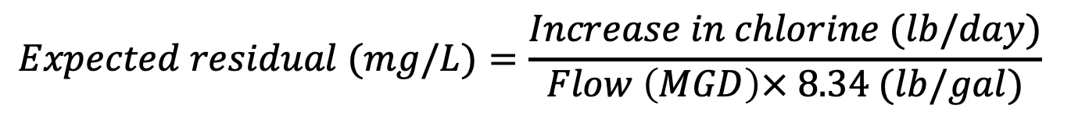
Step 1: Calculate expected increase in residual
$$Expected residual (mg/L)=\frac{Increase in chlorine (lb/day)}{Flow \left(MGD\right)× 8.34 (lb/gal)}$$
The equation says that the expected increase in residual is equal to the increase in chlorine divided by the flow times the constant: 8.34 lb/gal (which is the number of pounds of water per gallon).
Notes:
The first step in determining whether you have reached breakpoint chlorination is to calculate the expected increase in residual. The expected increase in the residual is equal to the increase in chlorine added during the treatment process in pounds per day, divided by the flow in megagallons per day times the number of pounds of water per gallon.

Slide 11
Step 2: Calculate actual increase in residual
$$Actual residual \left(mg/L\right)=New residual\left(mg/L\right)−Old residual\left(mg/L\right)$$
The equation says that the actual increase in residual is equal to the residual after more chlorine is added (new residual) minus the residual before more chlorine was added (old residual).
Notes:
The second step is to calculate the actual increase in residual that you observe when you increase the amount of chlorine. To do this, you subtract the old residual (before more chlorine was added) from the new residual (after more chlorine was added). The new and old residuals will be determined by laboratory testing conducted at the treatment plant.

Slide 12

Step 3: Compare the actual and expected increases in residual
If the actual residual is less than the expected residual, breakpoint was not reached!!
Notes:
The final step in determining if you have reached breakpoint chlorination is to compare the actual and expected increases in residual. If the actual residual is less than the expected residual, breakpoint chlorination was not reached! If the actual residual is greater than or equal to the expected residual, breakpoint was reached.

Slide 13
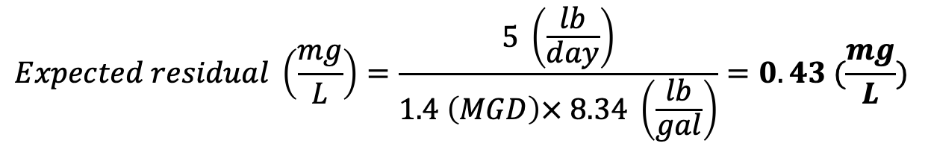
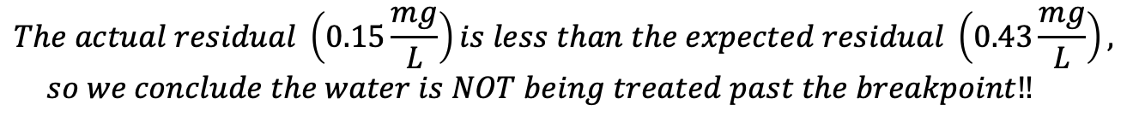
Example problem and solution
A chlorinator setting of 15 lbs chlorine per day results in a chlorine residual of 0.3 mg/L. The chlorinator setting is increased to 20 lb/day. The chlorine residual increases to 0.45 mg/L at this new dosage rate. The average flow being treated is 1.4 MGD. On the basis of these data, is the water being chlorinated past the breakpoint?
$$Expected residual \left(\frac{mg}{L}\right)=\frac{5 \left(\frac{lb}{day}\right)}{1.4 \left(MGD\right)× 8.34 \left(\frac{lb}{gal}\right)}=0.43 (\frac{mg}{L})$$
Step 1
Step 2
$$Actual residual \left(\frac{mg}{L}\right)=0.45\left(\frac{mg}{L}\right) −0.3\left(\frac{mg}{L}\right)=0.15 (\frac{mg}{L})$$
Step 3
$$The actual residual \left(0.15\frac{mg}{L}\right)is less than the expected residual \left(0.43\frac{mg}{L}\right),$$
$$so we conclude the water is NOT being treated past the breakpoint‼$$
Notes:
Now, let’s work an example problem. A chlorinator setting of 15 lbs chlorine per day results in a chlorine residual of 0.3 mg/L. The chlorinator setting is increased to 20 lb/day. The chlorine residual increases to 0.45 mg/L at this new dosage rate. The average flow being treated is 1.4 MGD. On the basis of these data, is the water being chlorinated past the breakpoint? First, we calculate the expected residual, which is the increase in chlorine (5 lb/day) divided by the flow (1.4 MGD) times the number of pounds of water per gallon (8.34 lb/gal). This gives us an expected residual of 0.43 mg/L of chlorine. Next, we calculate the actual residual, which is the old residual (0.3 mg/L) subtracted from the new residual after more chlorine was added (0.45 mg/L). This gives us an actual residual of 0.15 mg/L. Finally, we compare the actual and expected residual. We see that the actual residual of 0.15 mg/L is less than the expected residual of 0.43 mg/L, and so we conclude the water is NOT being treated past the breakpoint!

Slide 14
Goal #1: Ensure disinfection
Chlorine feed systems for secondary disinfection should achieve a minimum chlorine residual at the entry point of 0.2 mg/L for more than 4 hours
Maximum residual is 4.0 mg/L because of byproducts
Spring Hollow Reservoir Treatment Plant
Photo credit: Western Virginia Water Authority
Notes:
All of this information regarding breakpoint chlorination and residuals begs the question: how much residual should you aim for? Chlorine feed systems for secondary disinfection should achieve a minimum chlorine residual at the entry point of 0.2 mg/L for more than 4 hours. However, the
maximum allowed residual is 4.0 mg/L because of the risk of formation of disinfection byproducts, which we will discuss next.

Slide 15
Goal #2: Avoid DBP formation
The best approach is to remove DBP precursors prior to disinfection
Operators have several options:
Increased coagulation/clarification time or addition of more coagulant
Activated carbon filters that absorb organic matter
Pass water through a membrane that filters out DBP precursors
Spring Hollow Reservoir Treatment Plant
Photo credit: Western Virginia Water Authority
Notes:
The second goal for operators, in addition to ensuring disinfection, is to avoid DBP formation. The best approach to avoiding DBP formation is to remove DBP precursors prior to disinfection. To do this, operators have several options:
Increased coagulation/clarification time or addition of more coagulant
Activated carbon filters that absorb organic matter
Pass water through a membrane that filters out DBP precursors

Slide 16
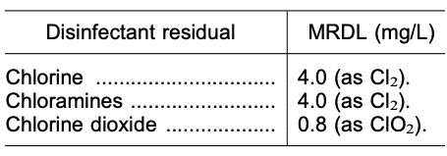
Goal #2: Avoid DBP formation
Because excessive free chlorine residual can lead to formation of DBPs in the distribution system, the EPA and VDH have enacted MRDLs, or maximum residual detection limits
Treated water must remain below these limits!!!
Source: https://www.govinfo.gov/content/pkg/FR-1998-12-16/pdf/98-32887.pdf#page=1
Notes:
Because excessive free chlorine residual can lead to formation of DBPs in the distribution system, the EPA and VDH have enacted MRDLs, or maximum residual detection limits. The table on the slide shows the MRDLs for three chlorine compounds that are commonly used for disinfection. The free chlorine residual in treated water must remain below the MRDLs listed in the table!

Slide 17
Strategy for balancing Goal #1 and Goal #2
Ensure water is chlorinated to breakpoint
Use additional treatment steps (increased coagulation, activated carbon filters, membrane technology) to remove DBP precursors prior to disinfection
Keep treated water under the EPA and VDH MRDL of 4.0 mg/L for free chlorine residual
Notes:
In summary, here is a high-level strategy for operators to balance the goals of ensuring disinfection and avoiding DBP formation. First, operators must ensure that water is chlorinated to breakpoint. Second, operators may use additional treatment steps as needed, such as increased coagulation, activated carbon filters, or membrane technology, to remove DBP precursors prior to disinfection. This helps avoid DBP formation in the treatment plant. Finally, operators must keep treated water under the EPA and VDH MRDL of 4.0 mgL for free chlorine residual. This helps avoid DBP formation in the distribution system.

Slide 18
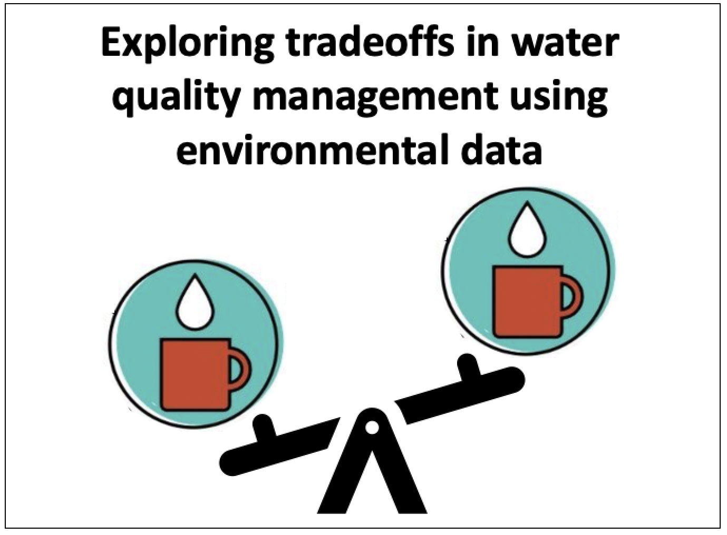
End of slideshow – please proceed with module activities!
Notes:
This is the end of the video; thanks for your attention!

